Slide 1





Prediction of the Main Programming Language Used in GitHub Repositories Using NLP & Classification Methodologies Garrett Williford & Jacqueline Shay Dec 12, 2019
GitHub
Collect Readme
Clean & Process Data
Explore Data
Model

Slide 2
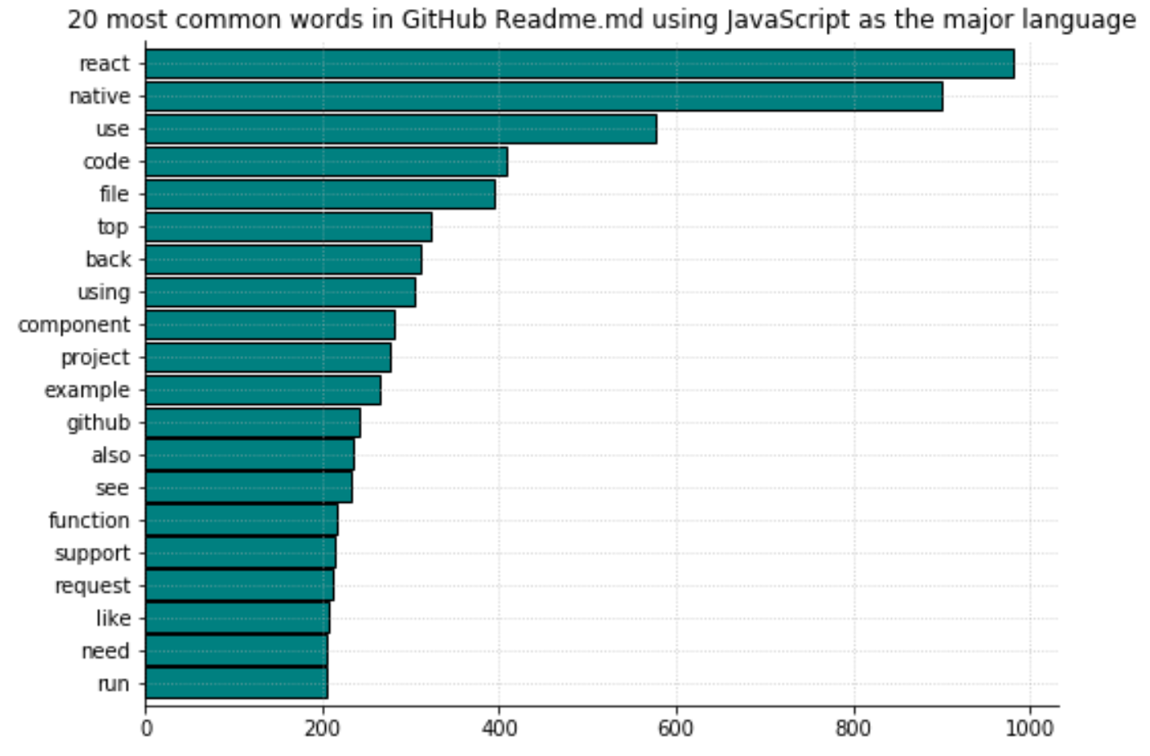
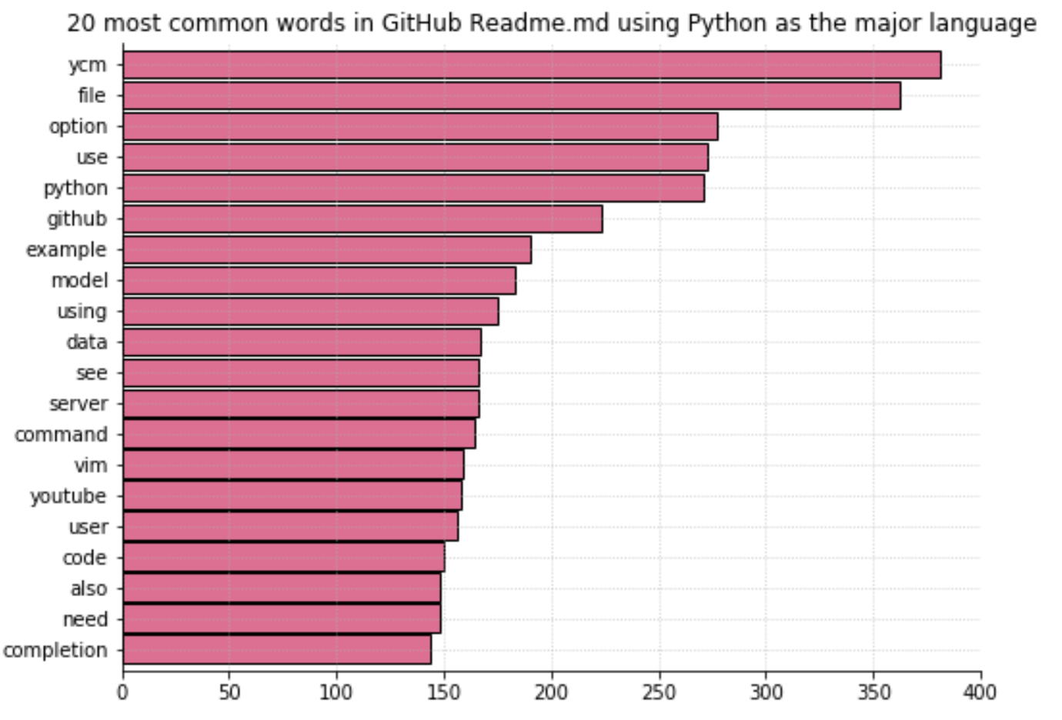
GitHub
Collect Readme
Clean & Process Data
Explore Data
Model

Slide 3
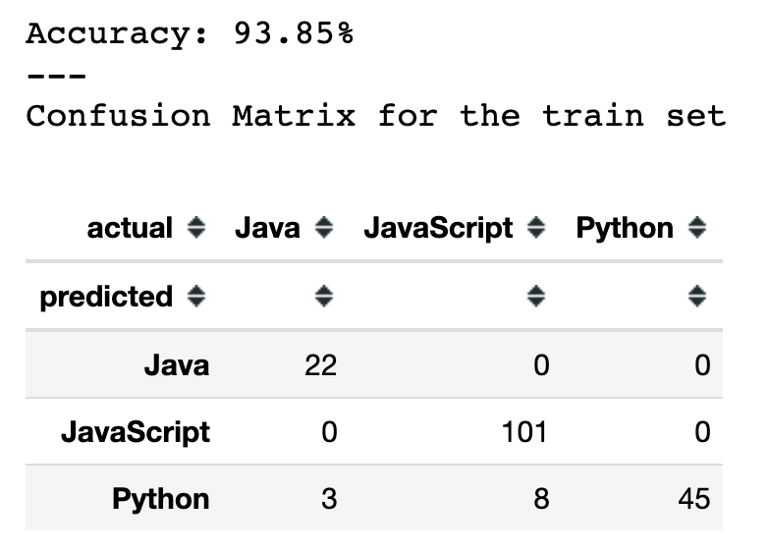
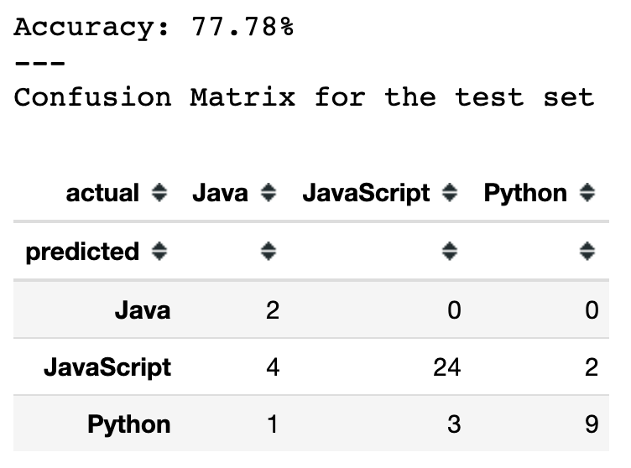
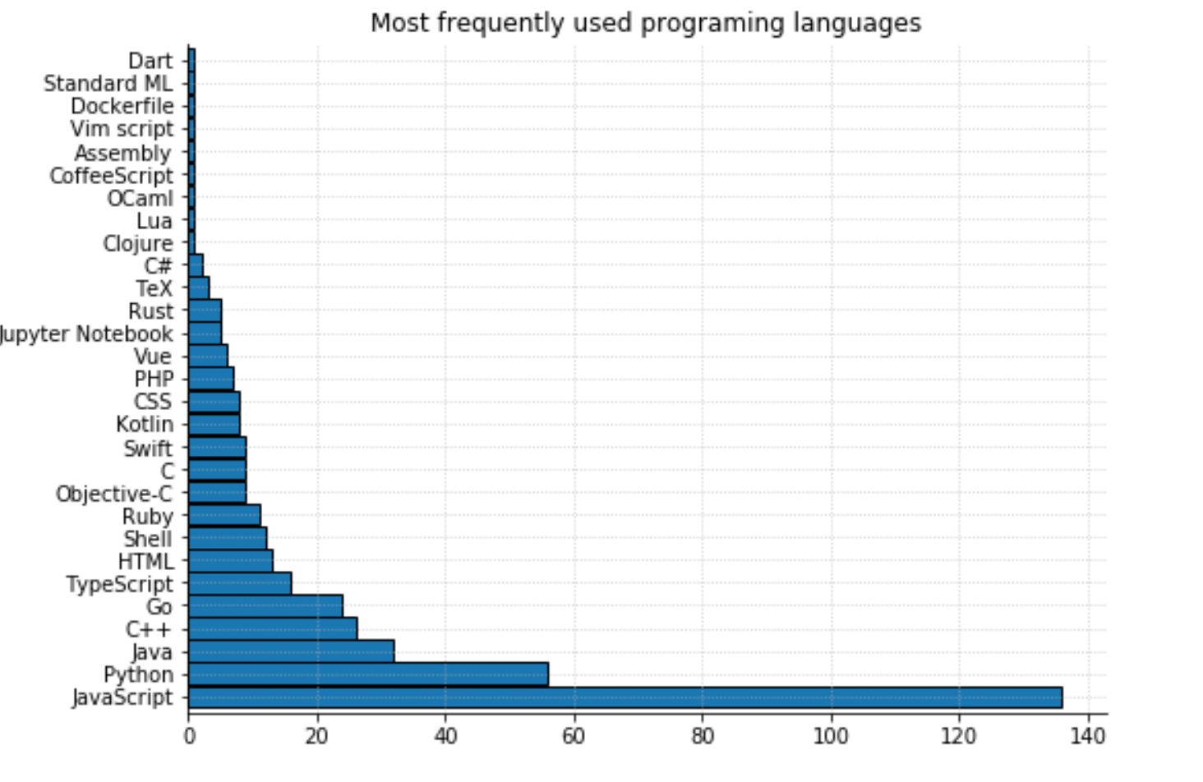
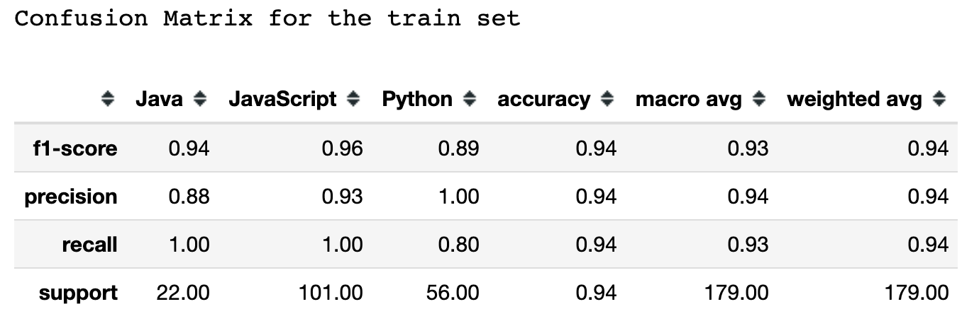
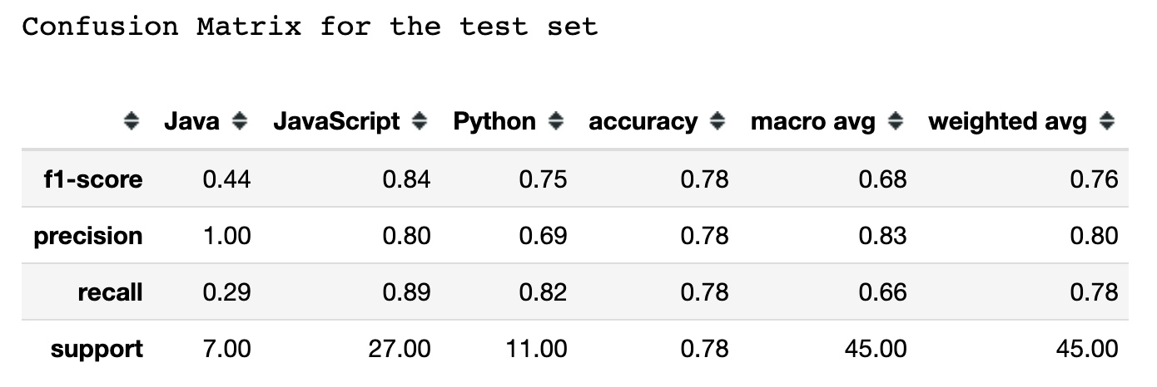

Slide 4








CONCLUSION AND THE FUTURE
1
2
3
4
5
A majority of the most starred projects on GitHub are written in JavaScript
The word react appears most in JavaScript READMEs. React also a JavaScript library.
Collect more data & more balanced number of samples per language.
Logistic regression is our best prediction model.

